Slide 1
ENERGY EFFICIENCY
By
NISIKANTA & RUCHIK
Technology bucket : MACHINE LEARNING Category : REGRESSION MODEL
Company Name : INEURON.AI PROJECT: INTERNSHIP PROGRAMME
UI : http://54.184.32.49/

Slide 2
INDEX:
Objectives
Data handling and EDA :
How to handle null values
To Analyze the correlation with all variables with target variable and other variables.
How to apply basic statistics to identify the data distribution.
Data preprocessing techniques
To learn about data preprocessing techniques.
Model selection process
To compare diferent model based on their accuracy
Analysing score of each models respectively.
Save the model for deployment
Deployment
How to deploy final model to aws cloud
How to create a docker file and deploy
Web interface
How to create web application (ui) based on requirements.
Problem statement
EDA
Model selection
Deployment
Outcome

Slide 3
PROBLEM STATEMENT :
To assess heating load and cooling load requirements of buildings (that is, energy efficiency) as a function of building parameters.
Data description :
We perform energy analysis using 12 different building shapes simulated in Ecotect. The buildings differ with respect to the glazing area, the glazing area distribution, and the orientation, amongst other parameters. We simulate various settings as functions of the afore-mentioned characteristics to obtain 768 building shapes. The dataset comprises 768 samples and 8 features, aiming to predict two real valued responses. It can also be used as a multi-class classification problem if the response is rounded to the nearest integer.
Attribute Information:
The dataset contains eight attributes (or features, denoted by X1...X8) and two responses (or outcomes, denoted by y1 and y2). The aim is to use the eight features to predict each of the two responses.
Specifically:
X1 Relative Compactness
X2 Surface Area
X3 Wall Area
X4 Roof Area
X5 Overall Height
X6 Orientation
X7 Glazing Area
X8 Glazing Area Distribution
y1 Heating Load
y2 Cooling Load

Slide 4
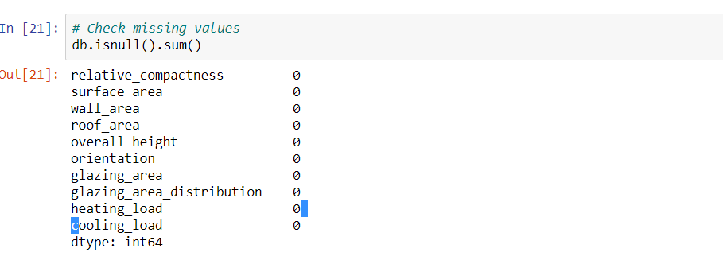
EDA :
After analysis we have observed that there are no null values present in the given data set.
In boxplot, we do not have outlier.
From heatmap it is observed that no values closer to 1 indicating that no two columns are correlated.
Hence we did not disturb any
features.

Slide 5
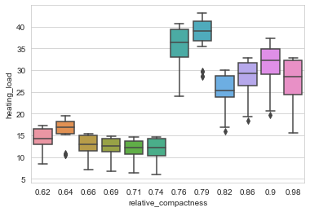
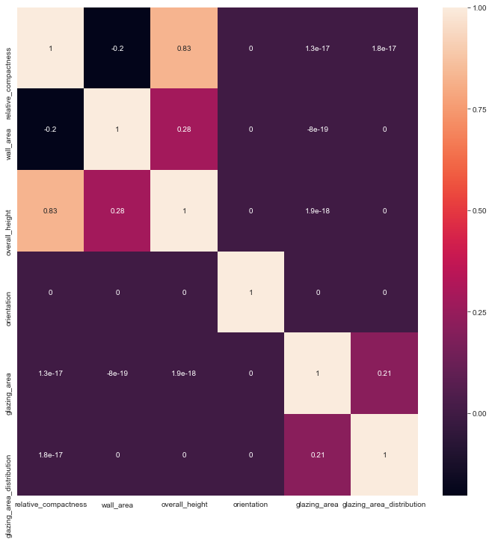
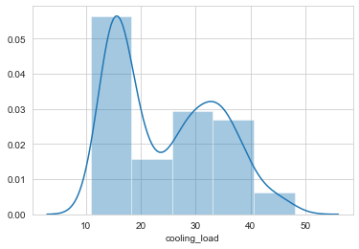
Heatmap analysis & box plot

Slide 6
Model Selection :
Based on the R2 score of various model like linear regression ,random forest, decision tree which is 90.3,97.9 & 98 respectively,we have choosen xgboost as our model.
R2 score of xgboost is noted as 99.5% accuracy. Which gave enough conclusion for choosing xgboost as our final model for prediction of given energy efficiency data set
API: we have provided single value and multi value (bulk)prediction through our api Using flask(python)

Slide 7
Deployment:
For the final deployment part we have used AWS services.
Ec2 instance is created and being used for deployment.
This deployment is compatible for all web browsers i.e( internet explorer. Google chrome. etc)
The following is/are the link for web deployed page :
http://54.184.32.49/

Slide 8
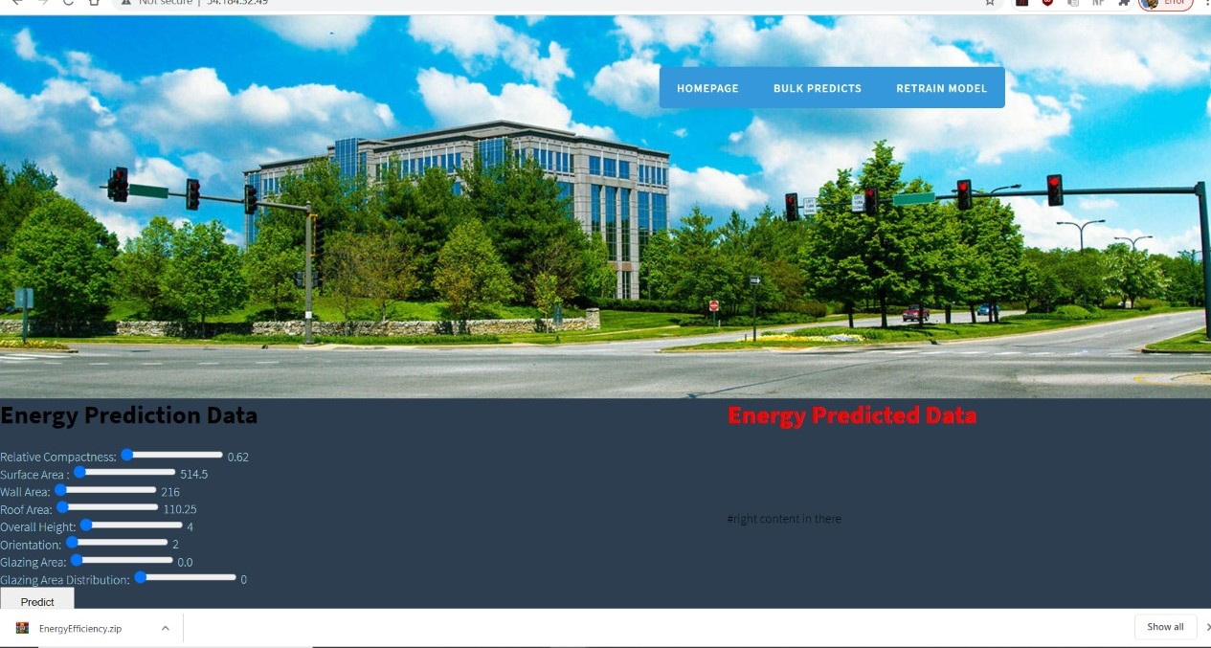
Single input & Multiple input predictions

Slide 9
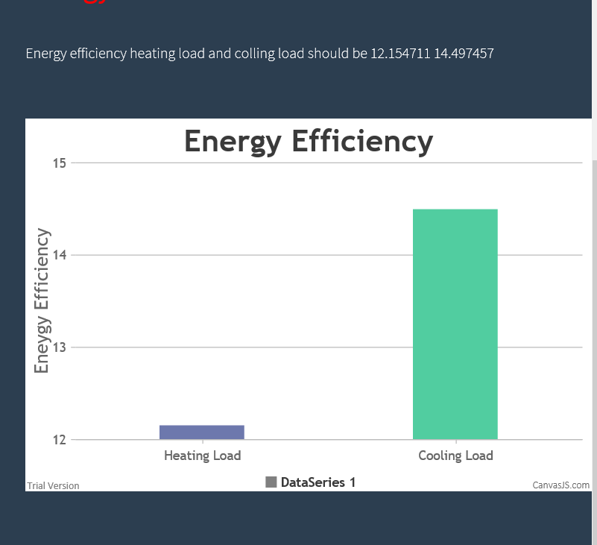
RESULT/OUTPUT/CONCLUSION:
The below is the final output for Heating & Cooling load predicted values.
The predicted values are represented in the same page in graphical representation.
For bulk prediction the , input csv file is given and the respected output predictions are downloaded as csv file to local system.

Slide 10
Thank you

